Slide 1
System Overview
Application

Slide 2
High Level System Context
MIS Model
Business Model
Management
Information System
Business Use Cases
Integration Platform
Social Media
Dashboard Services
Product Mgmt
Suppliers Mgmt
Facebook.com
Customer Mgmt
Order Mgmt
???????
Reporting Services
Sales Management
CRM Integration
Analytical Services
Salesforce.com
User Management

Slide 3



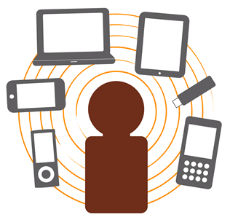



High Level Technical Architecture & Deployment Model
Public Users
Application
Firewall
Auth Services
Security
User Management
Auth Service Database
Firewall
Owin
&
Identity Server
Identity Server
Target
tcp 443 (https)
App Services
Reverse Proxy
tcp 80 (http)
tcp 80 (http)
Service
Repository
Web Application
Web API Services
Generic Service
Generic Repository
Angular 2.4
tcp 80 (http)
Application Database
ASP.NET MVC
Product Service
Product Repository
Corporate Users
Responsive Design
tcp 443 (https)
Reverse Proxy
Web API
Service Manager
tcp 80 (http)
Presentation
Application Layer
Data Layer
INTERNET
DMZ
DMZ
INTRANET
INTRANET

